Slide 1


SC1015 Mini Project: Bike Sharing
by Jonathan Chow, Jacob Rossman, Khant Zaw

Slide 2




Practical Motivation
Improve user experience: Data science can help bike sharing companies to improve the user experience for riders. By analyzing user behavior, bike sharing companies can identify pain points in the user journey and make improvements to the service.
Questions
Are we able to forecast the use of a bikeshare system?
Which model would fit our problem the best?

Slide 3

Steps we took in this project
1
2
3
4
5
STEP
STEP
STEP
STEP
STEP
Importing the dataset and studying its features
Cleaning the dataset. Removing outliers, normalising distribution, etc
Exploratory analysis
Model Fitting
Conclusion.
s.
.

Slide 4
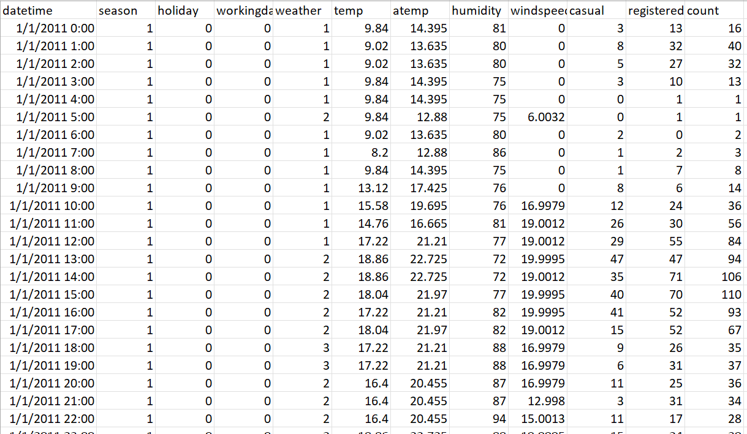

Our Dataset:
Bike Sharing Demand from Kaggle

Slide 5
Variables | Description | Variable | Description
Season | 1: spring 2: summer 3: fall 4: winter | Weather | 1: Clear, Few clouds, Partly cloudy, Partly cloudy 2: Mist + Cloudy, Mist + Broken clouds, Mist + Few clouds, Mist 3: Light Snow, Light Rain + Thunderstorm + Scattered clouds, Light Rain + Scattered clouds 4: Heavy Rain + Ice Pallets + Thunderstorm + Mist, Snow + Fog
Holiday | Whether the day is considered a holiday | Windspeed | wind speed
Workingday | whether the day is neither a weekend nor holiday | Casual | number of non-registered user rentals initiated
Humidity | relative humidity | Registered | number of registered user rentals initiated
Temp | temperature in Celsius | Count | number of total rentals
Atemp | "feels like" temperature in Celsius

Slide 6

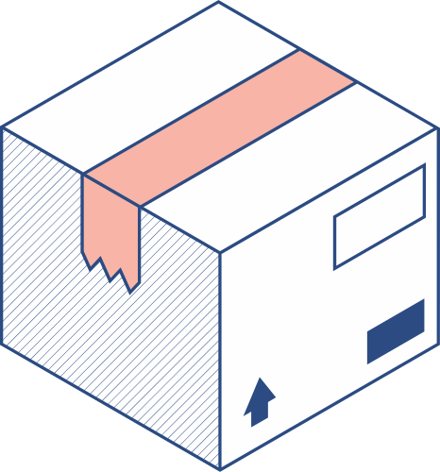


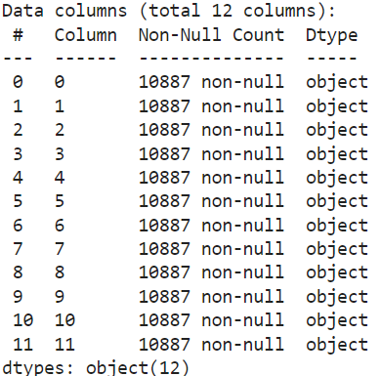
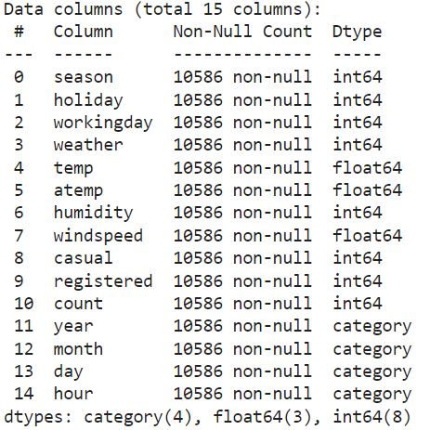
Formatting the data into correct data types

Slide 7
Extra points on our cleaning
Usage of Point Biserial Correlation Coefficient (PBCC) and Phi Coefficient
Also checked for NULL values and outliers and removed them

Slide 8
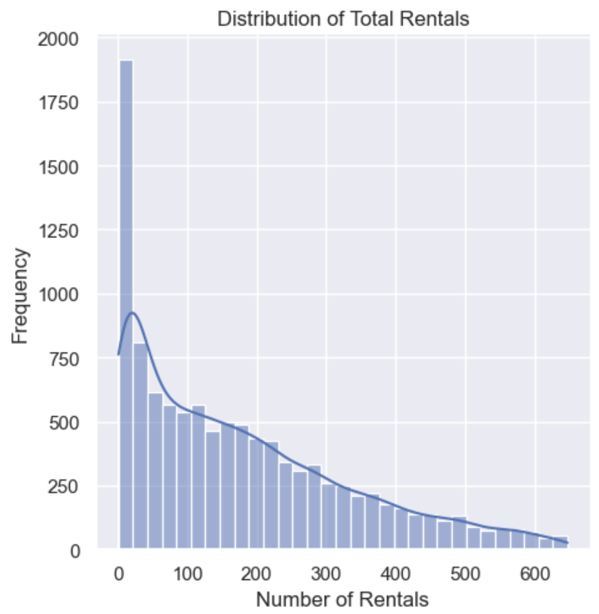
Data Analysis of response variable
Positively skewed distribution
Suggest a long tail to the right
May need to be addressed

Slide 9
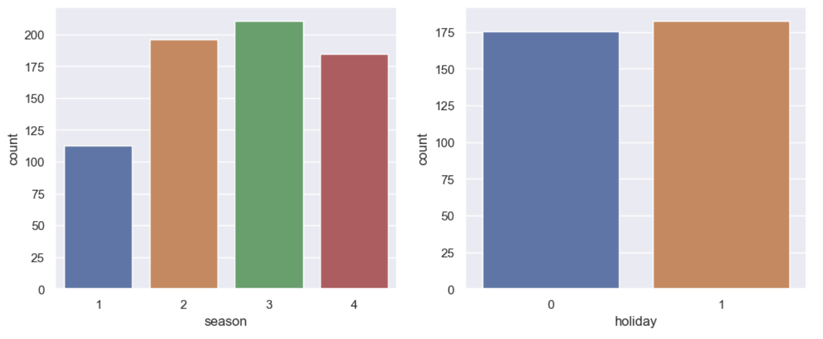
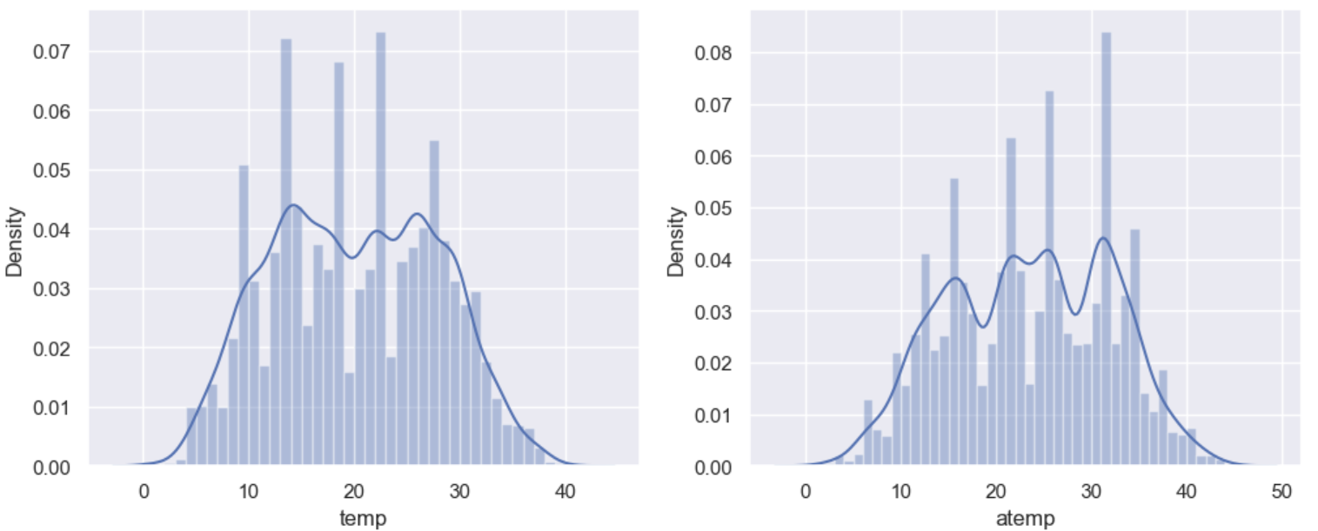
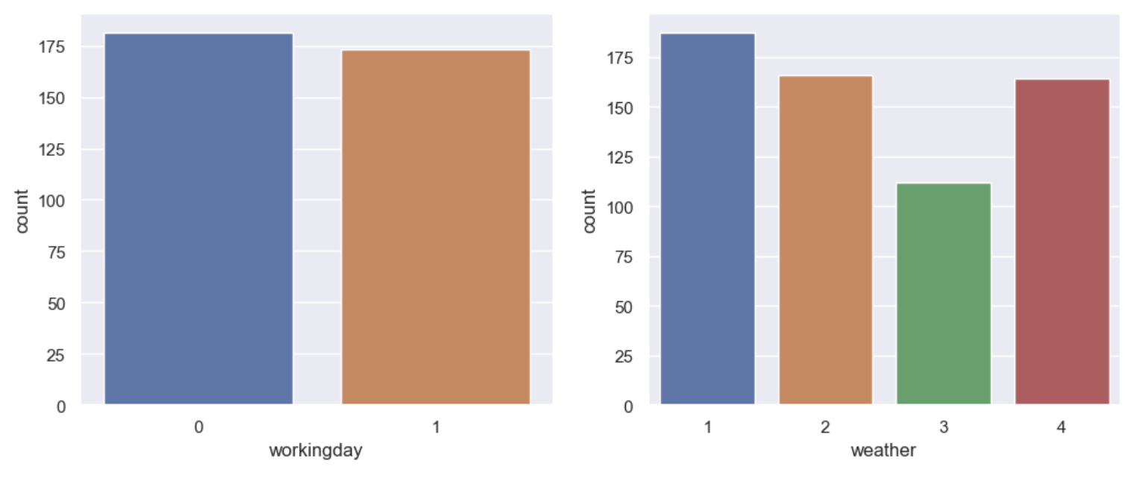
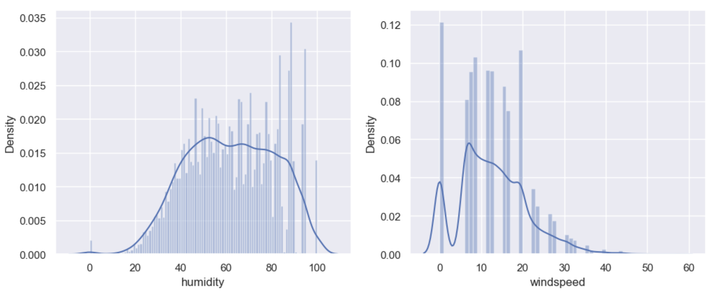
Categorical Variables
Numerical Variables

Slide 10
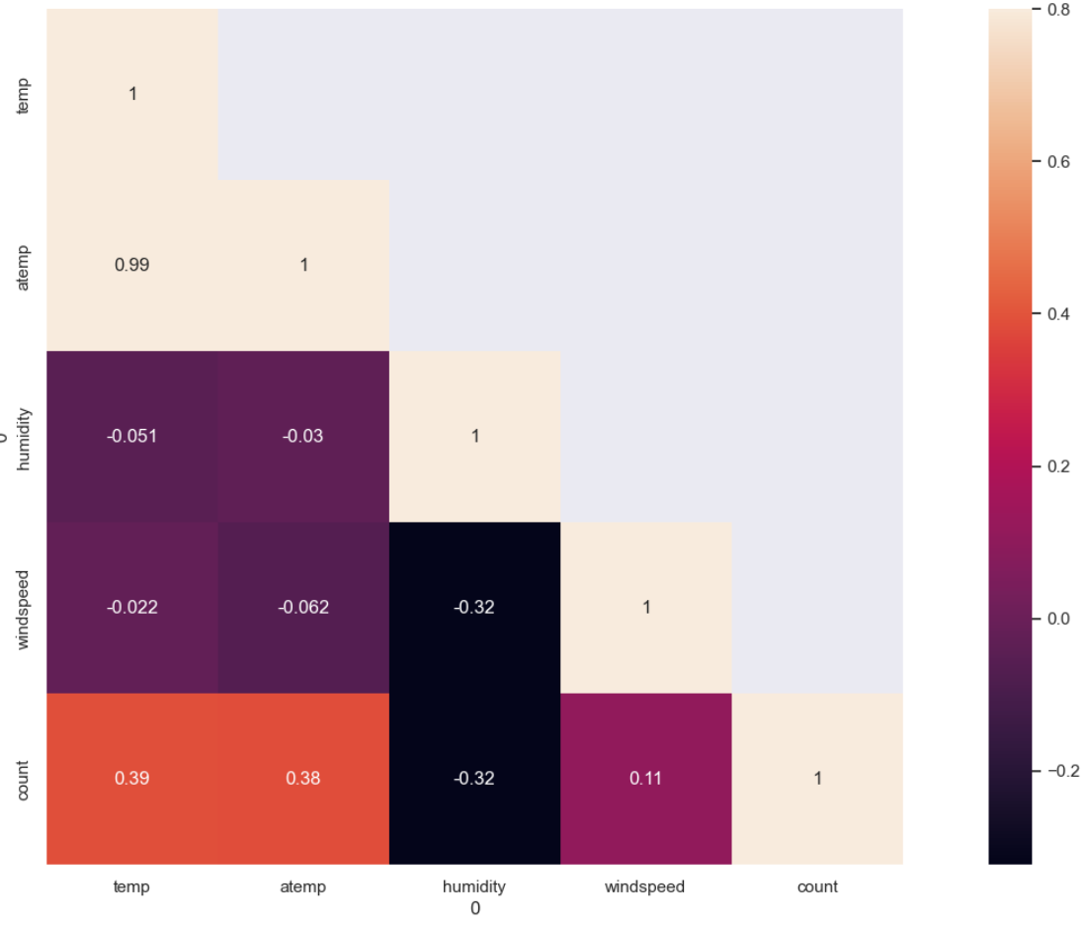
Numerical Variable Analysis
Count has some dependency on temp and humidity
Omit the relationship of atemp and temp

Slide 11
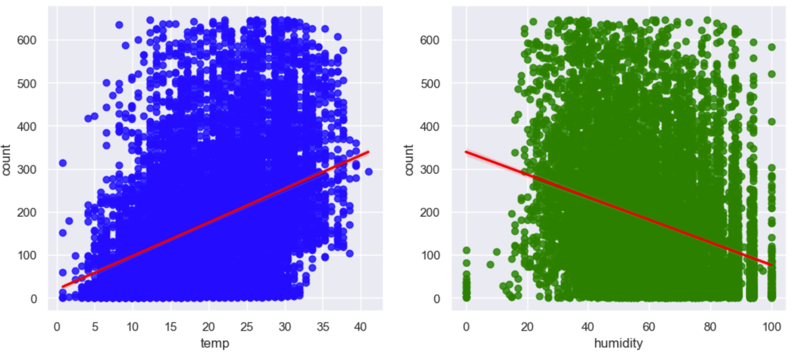
Temp and Humidity

Slide 12
Categorical Variable Analysis
Categorical Variable | Boolean? | Appropriate Measure for Correlation
season | No | Phi Coefficient
holiday | Yes | Point Biserial Correlation Coefficient
workingday | Yes | Point Biserial Correlation Coefficient
weather | No | Phi Coefficient
year | No | Phi Coefficient
month | No | Phi Coefficient
day | No | Phi Coefficient
hour | No | Phi Coefficient

Slide 13
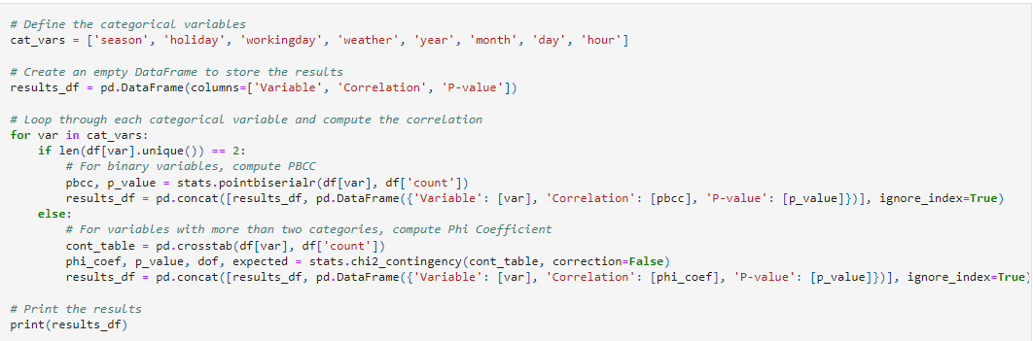
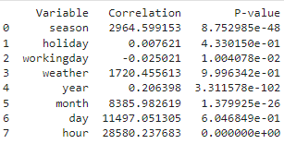

Slide 14
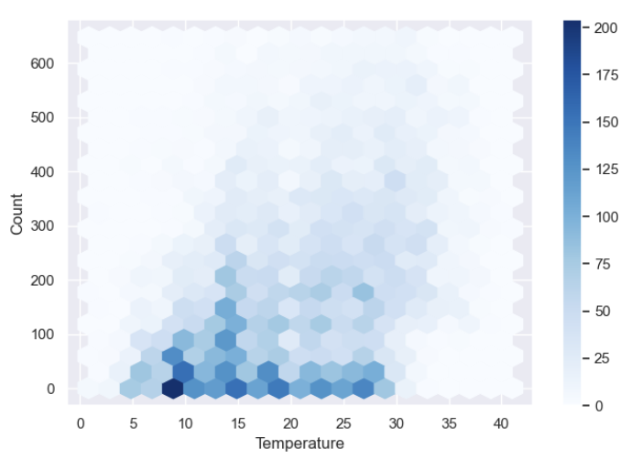
Hexbin Plot
Colour of density represented by the darkness of the hexes on the graph
Dark colour suggest strong relationship in that area

Slide 15
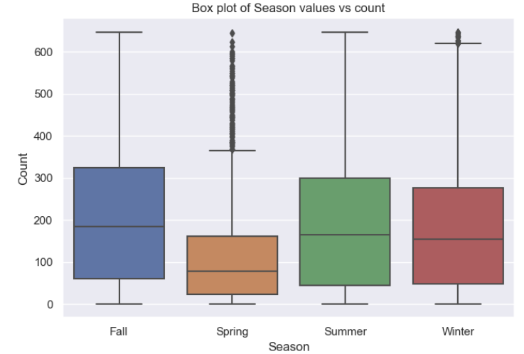
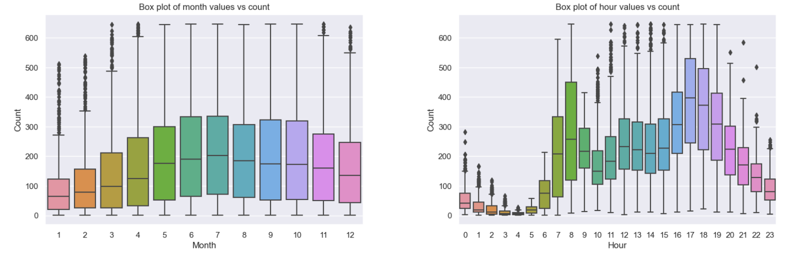
Box Plot (Season vs Count)
Spring significantly lower
Maybe time series will help

Slide 16
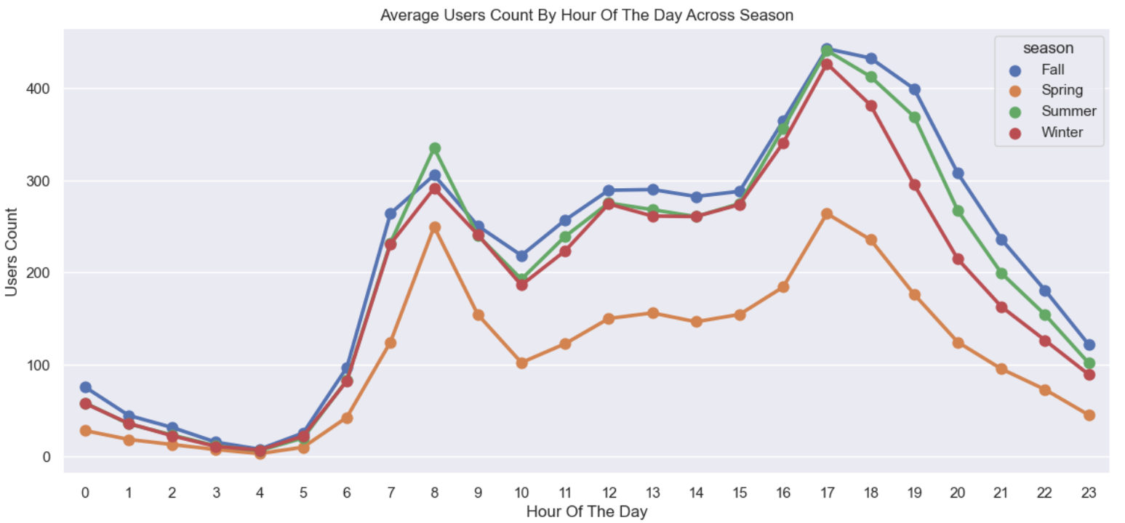
Timeseries
Spring indeed lowest count
Spike in count at 0800 and 1700 hours

Slide 17
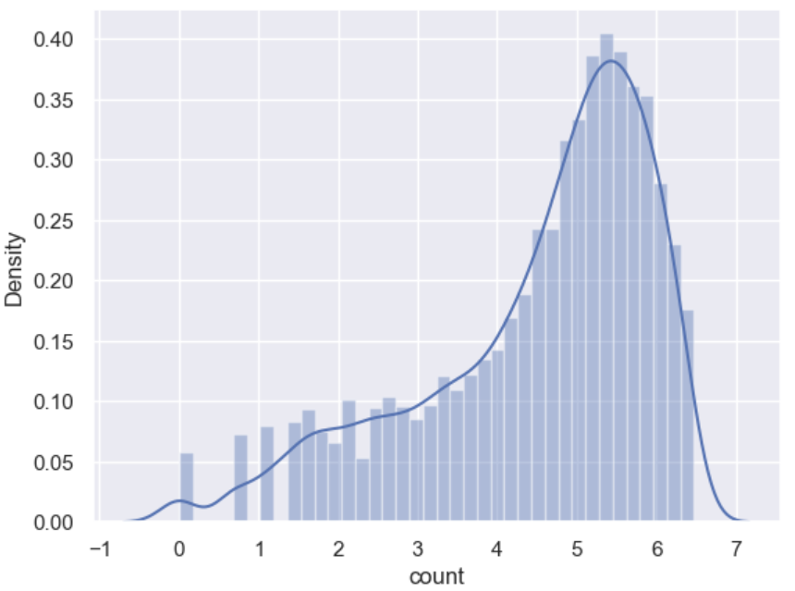
Normalizing the target variable
Target variable has highly skewed distribution
Tested Log, Square-root, Cox-Box
Log was best

Slide 18
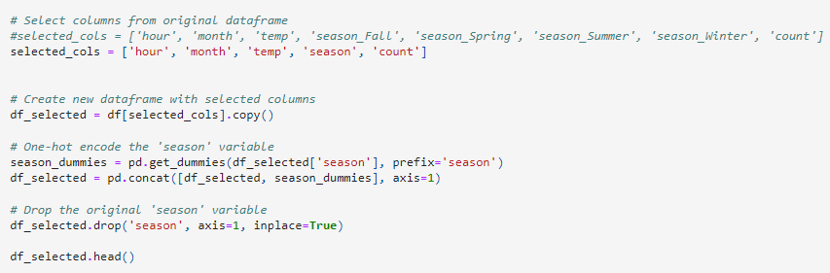
One Hot Encode

Slide 19
Model | Description
RandomForestRegressor | Fits ts a number of classifying decision trees on various sub-samples of the dataset and uses averaging to improve the predictive accuracy and control over-fitting.
AdaBoostRegressor | Begins by fitting a regressor on the original dataset and then fits additional copies of the regressor on the same dataset but where the weights of instances are adjusted according to the error of the current prediction. As such, subsequent regressors focus more on difficult cases.
BaggingRegressor | A Bagging regressor is an ensemble meta-estimator that fits base regressors each on random subsets of the original dataset and then aggregate their individual predictions (either by voting or by averaging) to form a final prediction.
SVR | Support Vector Regression is a supervised learning algorithm that is used to predict discrete values. Support Vector Regression uses the same principle as the SVMs. The basic idea behind SVR is to find the best fit line. In SVR, the best fit line is the hyperplane that has the maximum number of points
KNeighboursRegressor | Regression based on k-nearest neighbors.The target is predicted by local interpolation of the targets associated of the nearest neighbors in the training set.

Slide 20
Goodness of Fit of our Models
Model | RMSLE | MAE | RMSE | R^2
RandomForestRegressor | 0.2099 | 0.5825 | 0.7992 | 0.7051
AdaBoostRegressor | 0.2070 | 0.6427 | 0.8155 | 0.6930
BaggingRegressor | 0.2125 | 0.5907 | 0.8072 | 0.6992
SVR | 0.2519 | 0.6898 | 0.9325 | 0.5985
KNeighboursRegressor | 0.2008 | 0.5618 | 0.7632 | 0.7311
KNeighboursRegressor lowest RMSLE
Best performing model

Slide 21
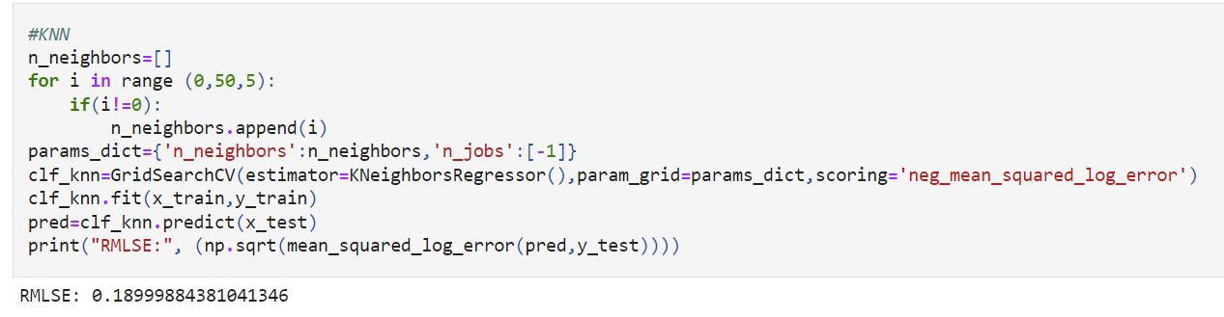
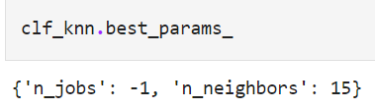
Hyperparameter Optimization
Code above uses grid search to find the optimal value of the hyperparameter n_neighbors
Output {'n_jobs': -1, 'n_neighbors': 15} indicates that the optimal hyperparameters for the KNN model, as determined by the grid search, are n_jobs=-1 and n_neighbors=15.

Slide 22
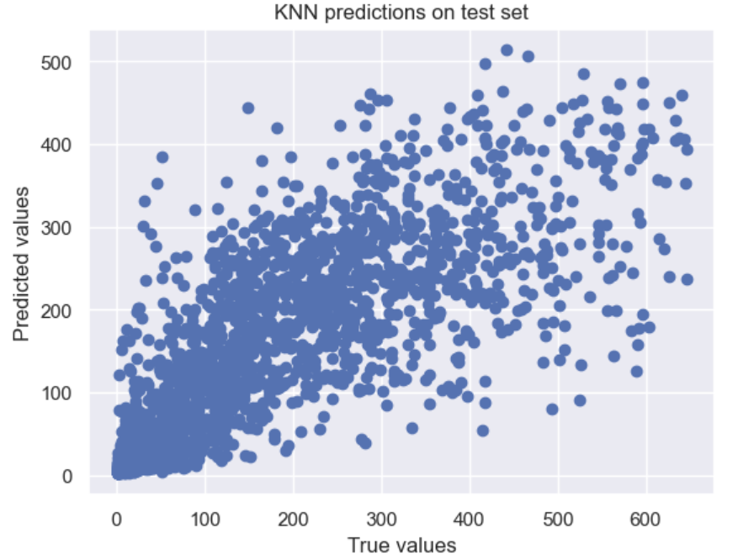
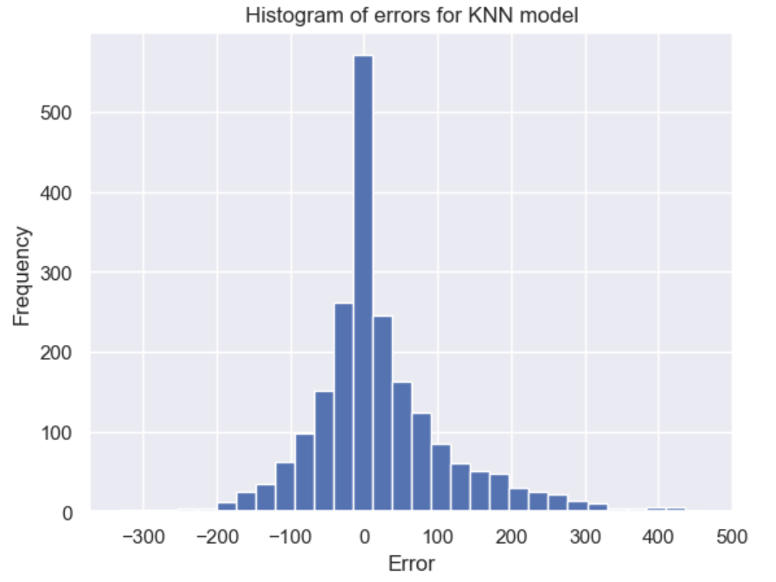
Dataset may be too large for scatter plot
Helps to visualize the distribution of errors and identify any patterns or biases in the predictions.
Model is able to keep a high frequency of predictions with low error, as evidenced by the high concentration of errors near zero in the middle of the histogram.

Slide 23
Overall
Usage of Kneighbours is the most accurate model for companies
Demand mainly depends on variables like temperature, season, month and hour.

Slide 24

Thank You

